Slide 1
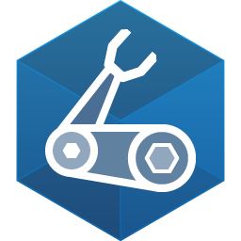








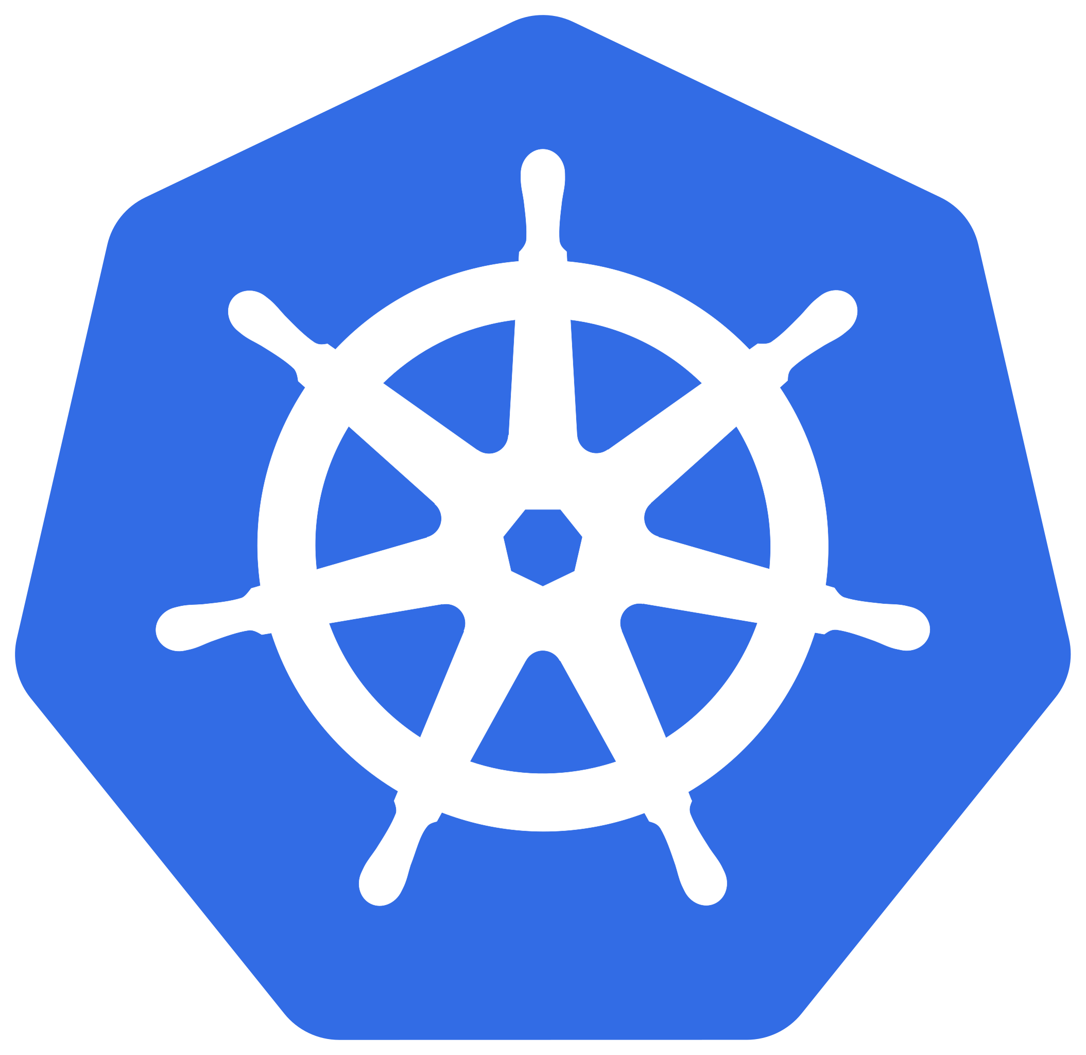


Azure IoT Operations/Edge AI – High Level Architecture
Bicep Automated Deployment
Edge
Cloud
Arc-enabled Kubernetes
Cloud-based workloads
Azure IoT Operations
Edge-based workloads
Edge Simulators
ML Model
Cerebral
SLM
Azure IoT Operations and ML/GenAI at the Edge on an a K3s Arc-enabled Kubernetes Cluster

